Slide 1
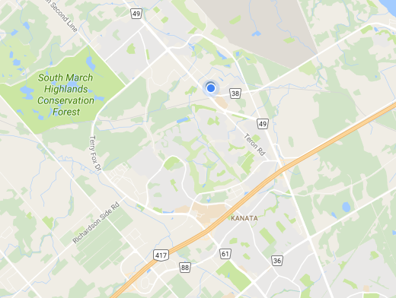
QLIK Mapping Extension
Family Swim
Lane Swim
Pool Closed
General Swim
4-5pm
3-4pm
2-3pm
1-2pm
Noon-1pm
11am-Noon
10-11am
9-10am
Richcraft Pool
Kanata Wave Pool

Slide 2
QLIK Mapping Extension
Family Swim
Lane Swim
Pool Closed
General Swim
4-5pm
3-4pm
2-3pm
1-2pm
Noon-1pm
11am-Noon
10-11am
9-10am
Richcraft Pool
Kanata Wave Pool

Slide 3
QLIK Mapping Extension
Family Swim
Lane Swim
Pool Closed
General Swim
4-5pm
3-4pm
2-3pm
1-2pm
Noon-1pm
11am-Noon
10-11am
9-10am
Richcraft Pool
Kanata Wave Pool

Slide 4
QLIK Mapping Extension
Family Swim
Lane Swim
Pool Closed
General Swim
4-5pm
3-4pm
2-3pm
1-2pm
Noon-1pm
11am-Noon
10-11am
9-10am
Richcraft Pool
Kanata Wave Pool

Slide 5
QLIK Mapping Extension
Family Swim
Lane Swim
Pool Closed
General Swim
4-5pm
3-4pm
2-3pm
1-2pm
Noon-1pm
11am-Noon
10-11am
9-10am
Richcraft Pool
Kanata Wave Pool

Slide 6
QLIK Mapping Extension
Family Swim
Lane Swim
Pool Closed
General Swim
4-5pm
3-4pm
2-3pm
1-2pm
Noon-1pm
11am-Noon
10-11am
9-10am
Richcraft Pool
Kanata Wave Pool

Slide 7
QLIK Mapping Extension
Family Swim
Lane Swim
Pool Closed
General Swim
4-5pm
3-4pm
2-3pm
1-2pm
Noon-1pm
11am-Noon
10-11am
9-10am
Richcraft Pool
Kanata Wave Pool

Slide 8
QLIK Mapping Extension
Family Swim
Lane Swim
Pool Closed
General Swim
4-5pm
3-4pm
2-3pm
1-2pm
Noon-1pm
11am-Noon
10-11am
9-10am
Richcraft Pool
Kanata Wave Pool

